Slide 1


Slide 2
PERFORMANCE APPRAISAL
WHO CAN BE THE APPRAISER,
PERFORMACE APPRAISAL METHODS

Slide 3
CONTENTS
Introduction
Who can be the Appraiser???
Performance appraisal methods
Traditional methods of appraisal
Modern methods of appraisal
Conclusion
References

Slide 4
INTRODUCTION
Performance appraisal is the annual review of employees over all contribution to company with his or her manager.
Performance appraisal are the part of career development and consist of regular reviews of employee performance within organizations.
Appraisal can be done by employees immediate managers, employees peers, himself or herself, subordinates etc.
There are mainly two methods of appraisal i.e.,
Traditional Appraisal Method
Modern Appraisal Methods

Slide 5

WHO CAN BE THE APPRAISER???
The immediate manager.
Other managers who are familiar with the employees work.
A higher level manager.
Personnel Department Specialist.
The employees peers.
Service users.
The employee himself.
The employees subordinates.

Slide 6
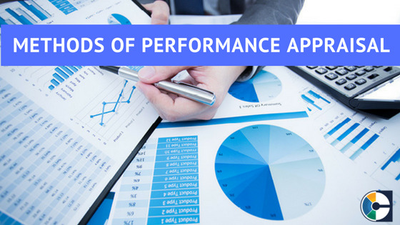
TRADITIONAL METHODS
MODERN METHODS

Slide 7
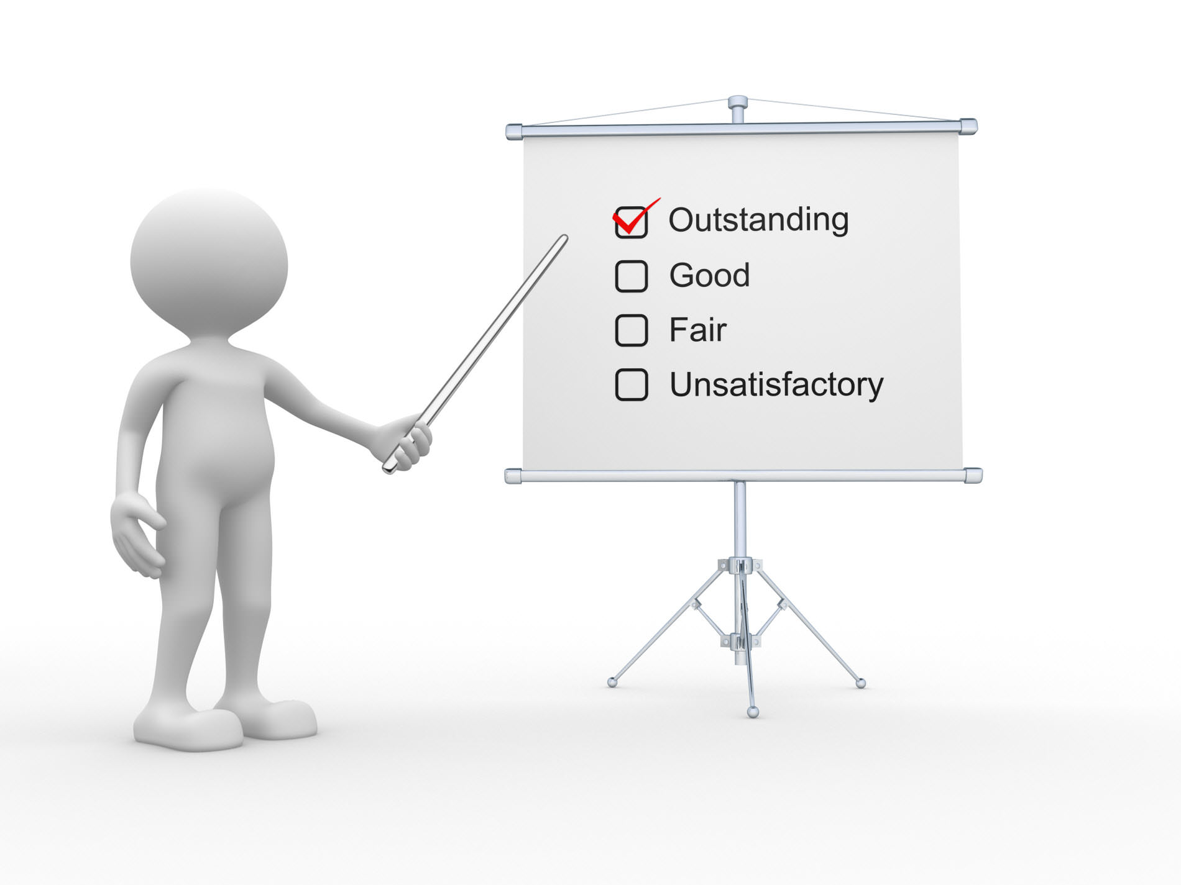
TRADITIONAL APPRAISAL METHODS
Ranking Method
Rating Scale Method
Check-list Method
Forced-choice Method
Field Review
Critical Incident Technique
Confidential Report
Essay Appraisal

Slide 8
TRADITIONAL METHODS
RANKING METHOD
The oldest and simplest method of Performance Appraisal.
The employees are ranked according to their relative levels of performance .
Rate employees from highest to lowest rank on some criteria.
RATING-SCALE METHOD
Rate employees according to the evaluators record, their judgment.
Two types
Discrete
Continuous

Slide 9
CONTINUING…
CHECK-LIST METHOD
Check-list method contains a list of statements on the basis of Performance.
Difficult to construct a good check-list.
FORCED-CHOICE METHOD
This method the rater is forced to select statements which are ready made.
The rater is asked to indicate which of the phrases is the most and least
FIELD REVIEW
The appraiser goes to the field and obtain the information about work performance.
Time consuming process

Slide 10
CONTINUING
CRITICAL INCIDENT TECHNIQUE
Managers prepares list of statements of very effective and in effective behaviour of an employee.
These critical incident represent the outstanding or poor behaviour of the employees.
The manager periodically records critical incidents of the employees behaviour.
CONFIDENTIAL REPORT
Report by employees immediate supervisors.
Report highlights the strengths and weakness of employees.
Prepared in government organisations.

Slide 11
ESSAY APPRAISAL
The rater is asked to express the strong as well as weak points of the employees behaviour.
Common method for appraising individuals for professional positions.

Slide 12
LIMITATIONS OF TRADITIONAL APPROACH
Most of these methods favour traits- based measures over those developed around behaviour.
Most of these methods are impressionistic & not data –based.
All traditional appraisal methods are like quality control systems.
Some of these methods do not give feedback to the appraise on his performance.
These methods lay greater stress on evaluating the employee for salary and reward administration, promotions & disciplinary action rather than developing him.

Slide 13

MODERN APPRAISAL METHODS
Management by Objectives (MBO)
Behaviourally Anchored Rating Scales (BARS)
Assessment Centres
360 – degree Appraisal
Team- oriented Appraisal
Development –oriented Appraisal

Slide 14
MANAGEMENT BY OBJECTIVES (MBO)
MBO is a process of agreeing upon objectives within an organization so the managers and employees agree to the objectieves and understand what they are in the organization.
A popular techniques of performance appraisal of managers now a days is MBO
The term popularized by Peter Drucker in his 1954
There are benefits and also limitation of MBO.

Slide 15
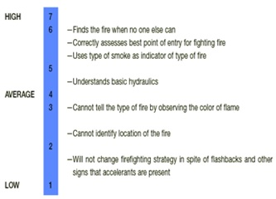
BEHAVIOURALLY ANCHORED RATING SCALE (BARS)
BARS represent a range of descriptive statements of behaviour varying from the least to the most effective.
In this a rater is expected to indicates which behaviour on each scale best describes an employees performance.

Slide 16
ASSESMENT CENTRES
In the performance appraisal, assessment centres can be used certify the competence of individuals to perform specific technical skills.
They can be used to evaluate candidates for managerial position, usually in combination with current performance appraisal.

Slide 17
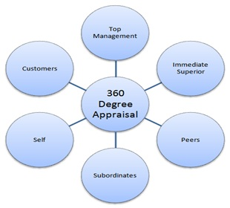
360 DEGREE APPRAISAL
Appraisal by superior
Appraisal by colleagues, peers
Appraisal by subordinates
Appraisal by external customers.

Slide 18

TEAM ORIENTED APPRAISAL
Customer satisfaction
Inter team transactions
Process steps

Slide 19
CONCLUSION
Discussed about
There are various appraiser who are surrounding us through them we can improve our performance
There are both two methods of performance appraisal ie., traditional methods and modern methods

Slide 20
REFERENCES
P.C Tripathy. Human Resource Development, Sulthan Chand and Sons,
New Delhi.
Deb.T. Human Resource Development.,Parwana Bhavan.,New Delhi.
https://www.education observer.com
https://corehr.wordpress.com.

Slide 21


